Slide 1
Cyber Security JOBS
Ali Abdelhamid

Slide 2
Table of contents
Method of Data Collection
Statistics
​Dream Job Road Map

Slide 3
Method of data collection
During the span of 10 days, I used LinkedIn job search, as well as Glassdoor, Expertini, and Wuzzuf to collect a total of 130 cybersecurity jobs scattered around Egypt.
I also tried using a web scrapper such as octoparse in order to collect multiple jobs at a quicker rate.
I inputted all the collected data into excel then imported it all into power BI in order to transform it all into graphs.

Slide 4
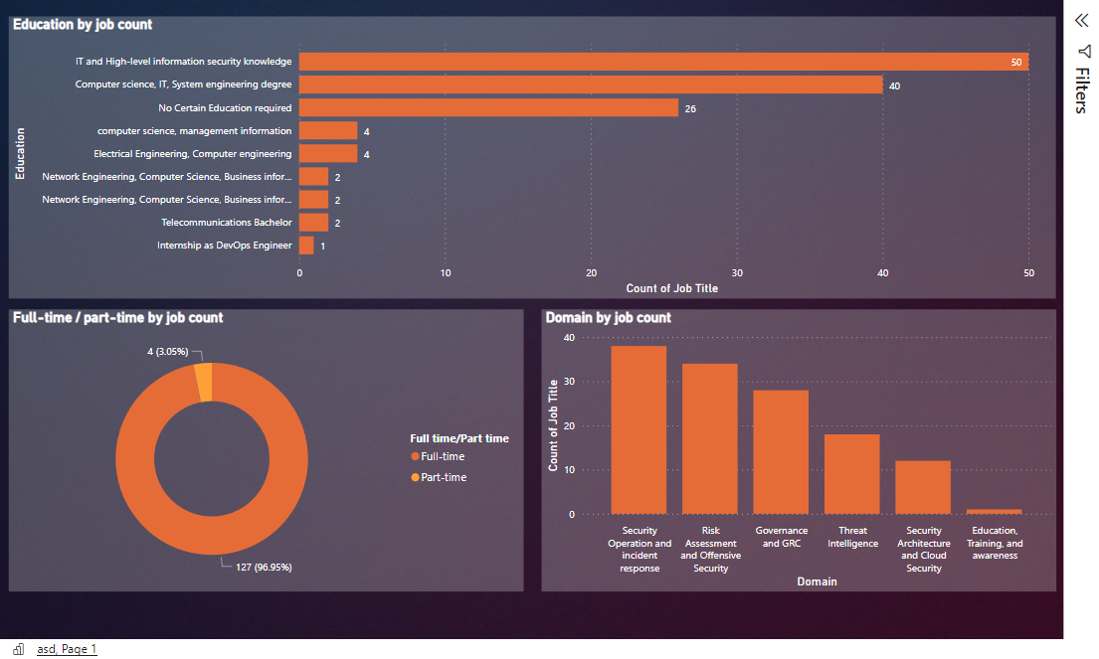

Slide 5
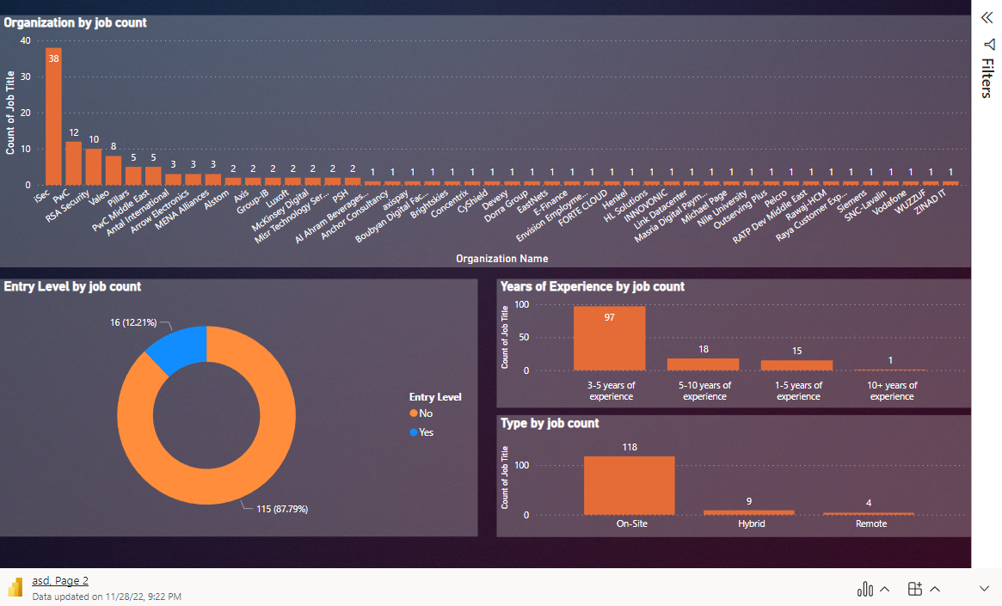

Slide 6
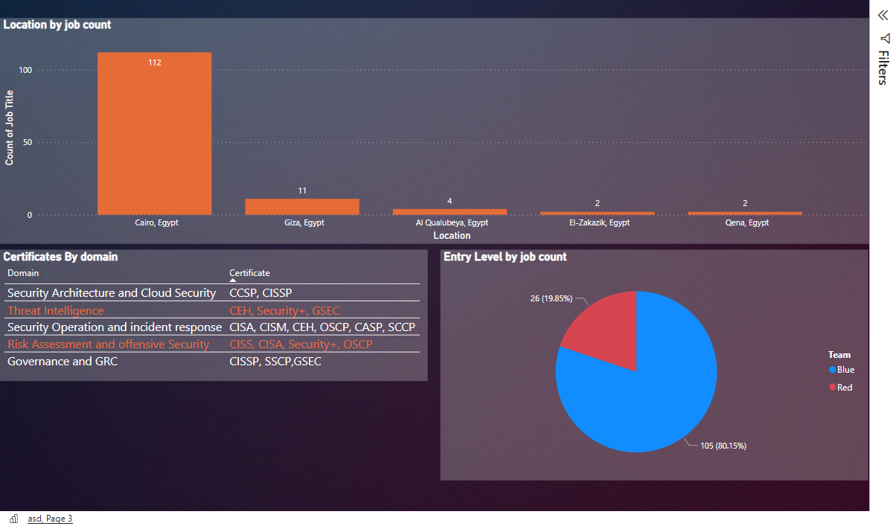

Slide 7
Dream job road map

Slide 8
TIMELINE
Certificates needed
DURING COLLEGE
During vacation
After college
After masters
-CSSP
-SSCP
-PenTest+
-Security+
-ITIL
-CES
-CAC
-A+
I plan on taking multiple courses that would eventually lead me to taking OSCP certification which in my opinion is one the hardest certificates to achieve
Participate in multiple cybersecurity internships, although it is not a requirement that they be pen testing as any internship in the field would benefit me greatly
Complete my master's degree in Cyber security abroad
Start looking for a job, using this exact same method I've used during the completion of this course work

Slide 9



HOW I’LL GET THERE
Strengths
Weaknesses
Target companies
I think outside the box which is much needed in the pen testing field
Team Player, this will be of great benefit due to the high probability of working in a team
Solid writer, since reporting to seniors is a major part of the job
I need more practical training such as CTFs
I need more work and internship experience in the field due to the scarcity of it
None till this date

Slide 10
THANK YOU
Ali Abdelhamid
Alielfekki@gmail.com
https://www.linkedin.com/in/ali-abdelhamid-b456a81a9/

